Slide 1

ENTERPRISE-SCALE
E-COMMERCE DATA PLATFORM
Real-Time Streaming • Batch Processing • Cloud Data Lake • Analytics
PROJECT PRESENTATION
TEAM MEMBERS
2420030478 — T. Viswanath Reddy
2420030300 — Siril Punna
2420030290 — D. Kamal Kumar
Faculty: Dr. N Sirisha
01

Slide 2
METHODOLOGY
Structured approach from requirements to analytics
01
REQUIREMENT
ANALYSIS
02
SYSTEM DESIGN
03
DATA INGESTION
Identify data sources, business metrics, security and scalability needs.
Define pipeline architecture, storage layers and processing flow.
Collect e-commerce events through Apache Kafka.
04
PROCESSING
05
STORAGE & QUALITY
06
ANALYTICS
Apply real-time processing with Spark Structured Streaming and batch workflows.
Organize data using Bronze–Silver–Gold layers with validation.
Publish business-ready datasets and dashboards for decision support.
03

Slide 3
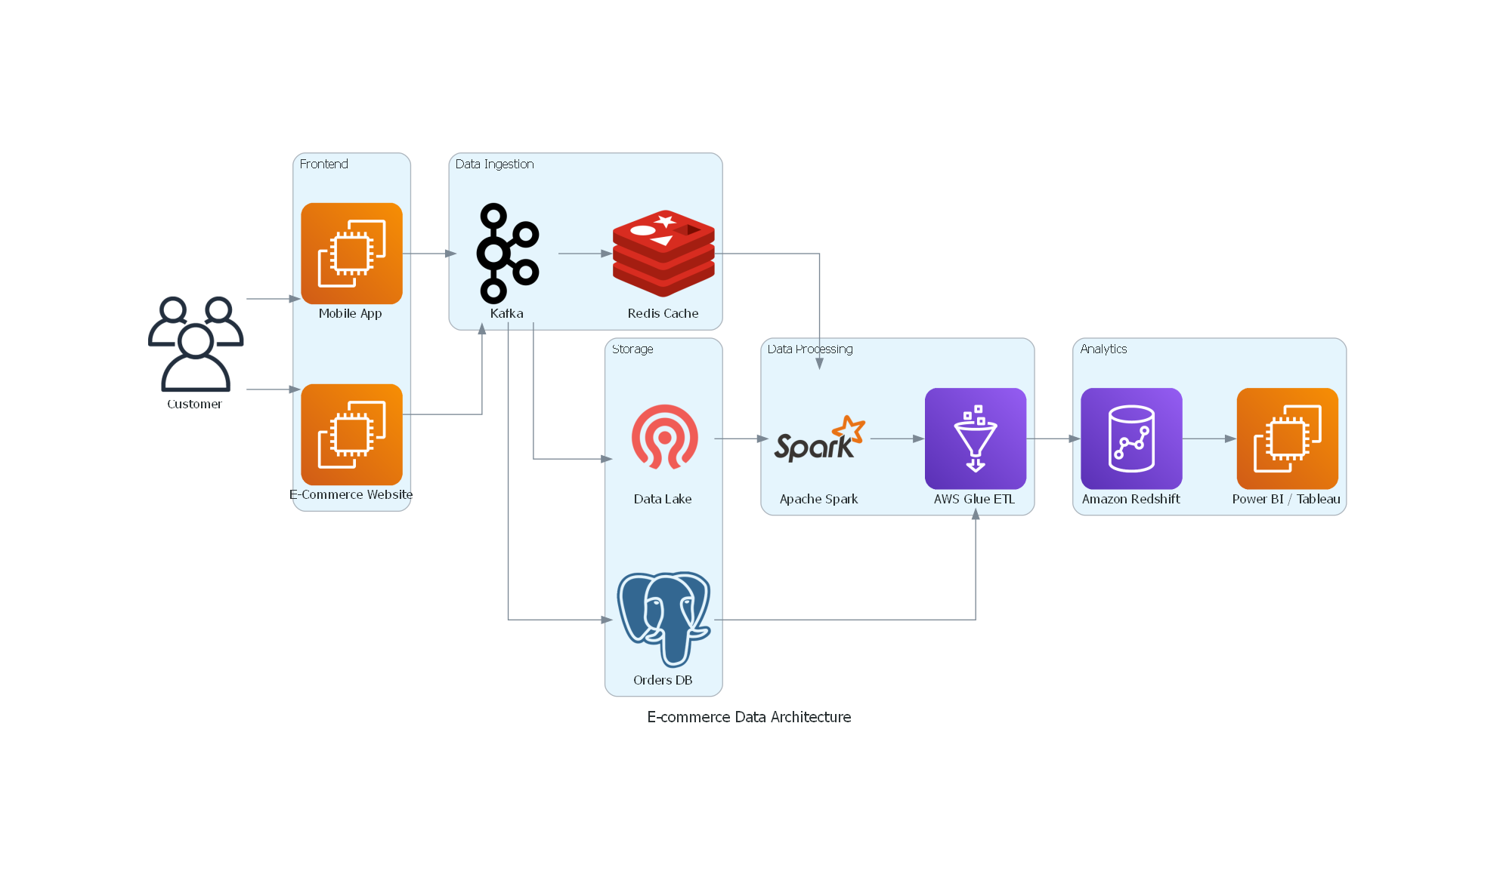
SYSTEM DESIGN & ARCHITECTURE
Unified real-time + batch data pipeline
Scalable storage • Fault tolerance • Data quality • Security • Monitoring
04

Slide 4
USE OF MODERN TOOLS & TECHNOLOGIES
Technology stack mapped to each stage of the platform
INGESTION
PROCESSING
ORCHESTRATION
Apache Kafka
Real-time event collection
Apache Spark
Structured Streaming for live processing
Apache Airflow
Automates batch workflows
DATA LAKE
WAREHOUSE
VISUALIZATION
Amazon S3
Scalable cloud-based raw and processed storage
Redshift / Snowflake
Business-ready analytical datasets
Power BI / Tableau
Interactive analytics dashboards
Core principle: choose purpose-built technologies for ingestion, processing, storage, orchestration and analytics.
05

Slide 5

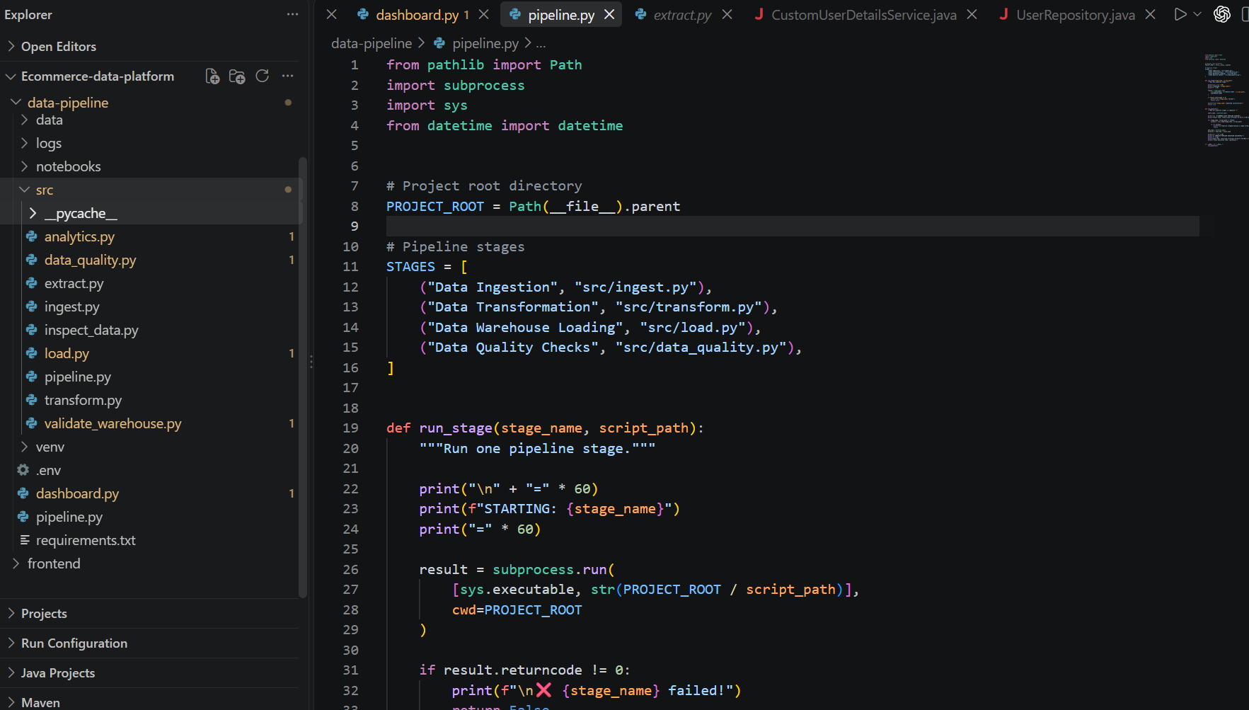

IMPLEMENTATION

Slide 6
CODING QUALITY & FUNCTIONALITY
How the proposed platform is organized for reliable development
CODING QUALITY
FUNCTIONALITY
• Modular pipeline components
• Clear separation of responsibilities
• Reusable transformations
• Data validation and quality checks
• Logging and monitoring
• Fault-tolerant processing
• Real-time event processing
• Batch + streaming integration
• Revenue and order analytics
• Customer activity analysis
• Product and inventory monitoring
• Dashboard-ready outputs
06

Slide 7
END-TO-END DATA FLOW
VISUALIZE
Power BI / Tableau
From raw e-commerce events to actionable business insights
DATA SOURCES
Clicks • Products • Orders • Payments • Inventory
INGEST
Kafka
PROCESS
Spark Streaming + Airflow
STORE
S3 + Bronze/Silver/Gold
ANALYZE
Warehouse + SQL
KEY BUSINESS METRICS
Sales Revenue
Order Volume
Customer Activity
Product Performance
Inventory Levels
Conversion & Cart Abandonment
07

Slide 8
THANK YOU
Enterprise-Scale E-Commerce Data Platform
T. Viswanath Reddy • Siril Punna • D. Kamal Kumar
09

